Slide 1
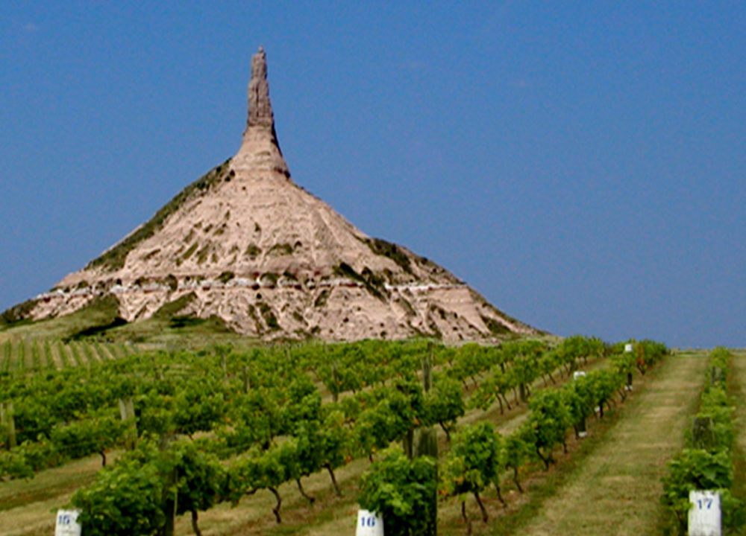
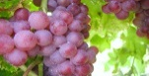
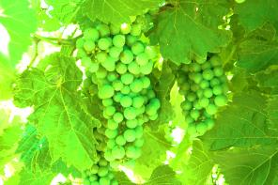
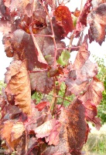
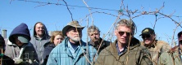
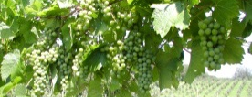
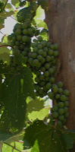
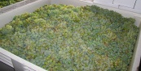
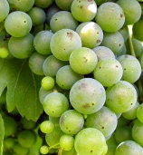
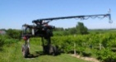
“Nebraska”
the next
Napa Valley?
viticulture.unl.edu

Slide 2
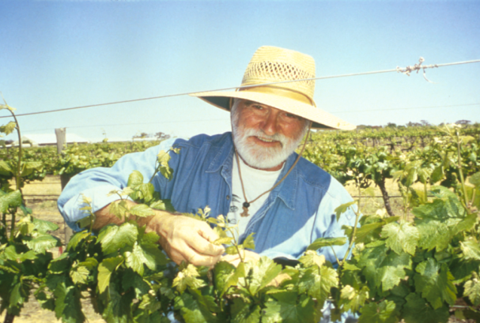
Paul Read Professor of Viticulture

Slide 3
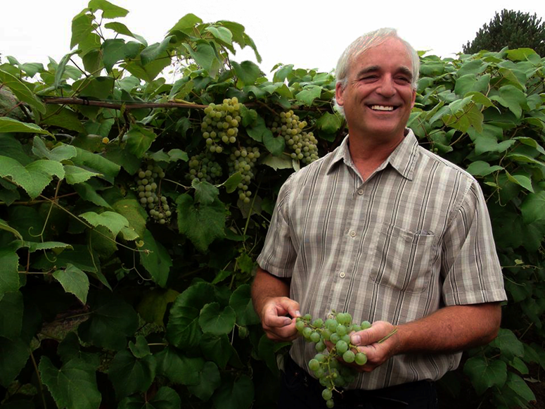
Stephen Gamet
Viticulture Field Technician

Slide 4
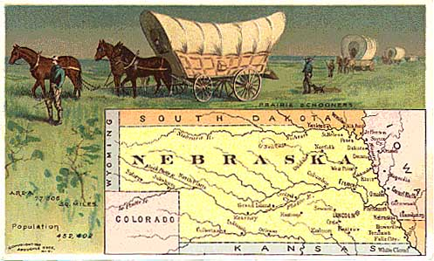
In the late 1800s to early 1900s there were many plantings of grapes and other fruits by immigrants to Nebraska

Slide 5
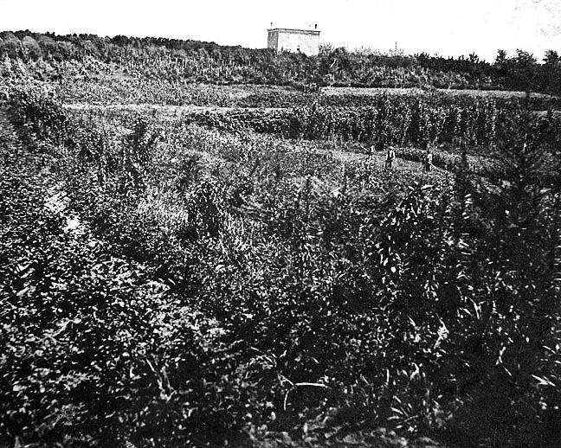
1910- ca. 5000 Acres in 11
Eastern Nebraska counties
This is a picture of several
acres of grapes in the early
1900’s by Brownville, NE
in South East Nebraska.
Notes:
Highway 136 and 67 South West corner Gov. Furnas

Slide 6
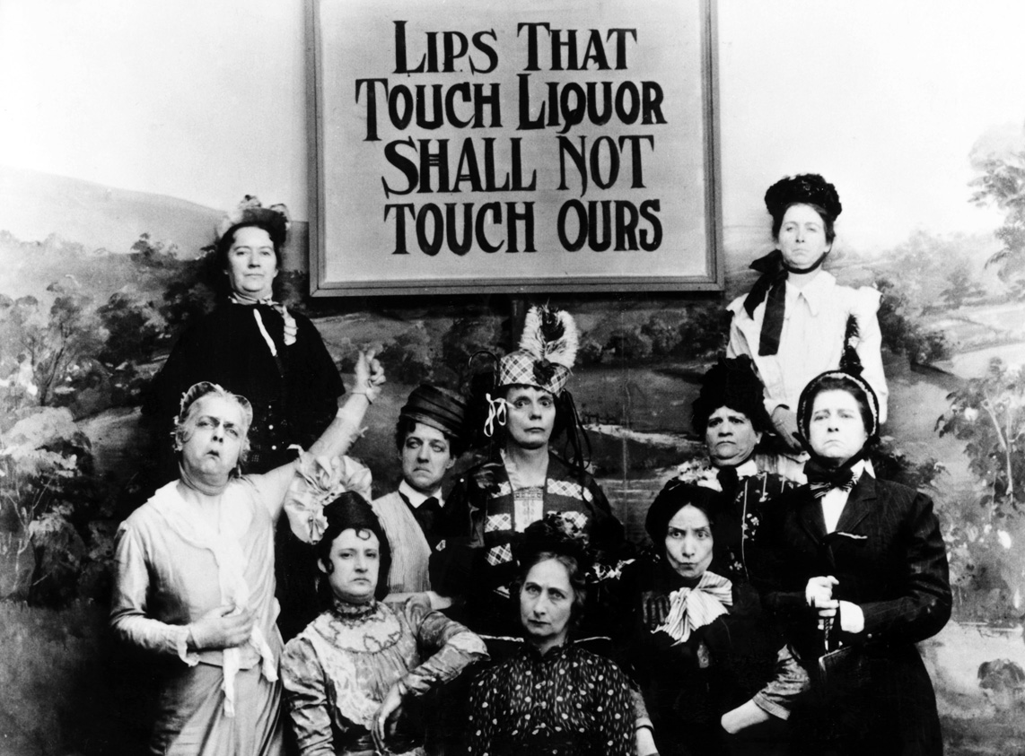
1919- Prohibition
(18th Amendment to U.S. Constitution)
Notes:
Tax – Prior to the 1913 creation of the national income tax 1/3 of Uncle Sam's taxes came from liquor. After WWI influx of tax revenues was so great that they decided they didn’t need liquor taxes till the early 30’s and tax revenues fell. Temperance movement

Slide 7
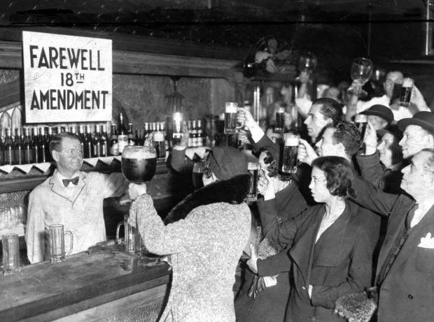
1933- Prohibition is repealed; management of alcoholic beverages is placed under each individual state’s control
Notes:
Drop in Income tax revenues 1930-31 by 15% 1932 by another 37% till 1933 it was down a full 60% of 1930.
Repeal Dec. 5, 1933
Each State then was in control of its own liquor laws.

Slide 8
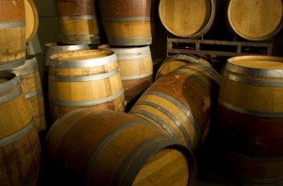
1985- The Nebraska Farm Wineries Act
is passed
-maximum of 50,000 gallons/year
-over 15,000 gallons –
wineries must go through a distributor
(changed to 30,000 gallons in 2003)
-75% Nebraska grown product used for
wine production
25% can be brought
in from out of state
Notes:
Sandra Scofield
Nov. 11, 1940 Armistice Day Freeze
farm subsidies
Nebraska Table Wine – American Table Wine
Full circle ag industries

Slide 9
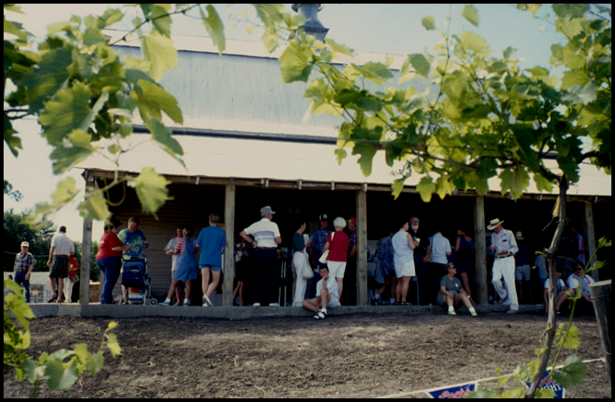
1994- Cuthills Vineyards opens as
Nebraska’s first winery
ca. 10 acres of commercial grapes in Nebraska

Slide 10
June, 1997- University of Nebraska Viticulture Program initiated
1997- Two bills passed by Nebraska Legislature:
- allowing consumption on premises
- allowing shipping of Nebraska wines

Slide 11
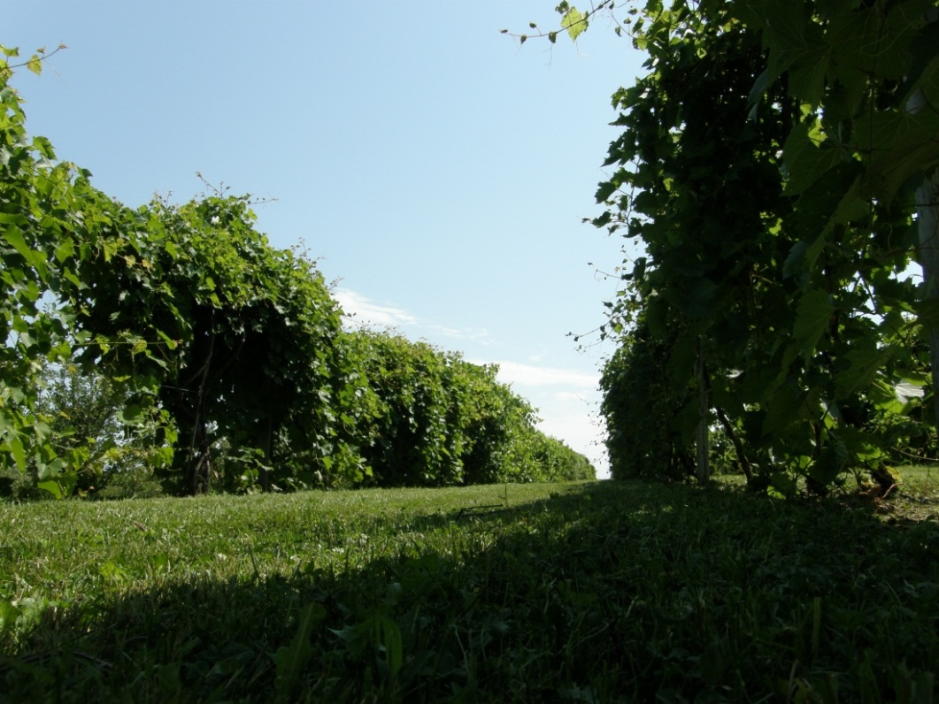
September, 1997-
James Arthur Vineyards opens
In May of 1998-
University of Nebraska
Viticulture Program
established
research plantings
in Nemaha,
Pawnee and
Otoe counties

Slide 12
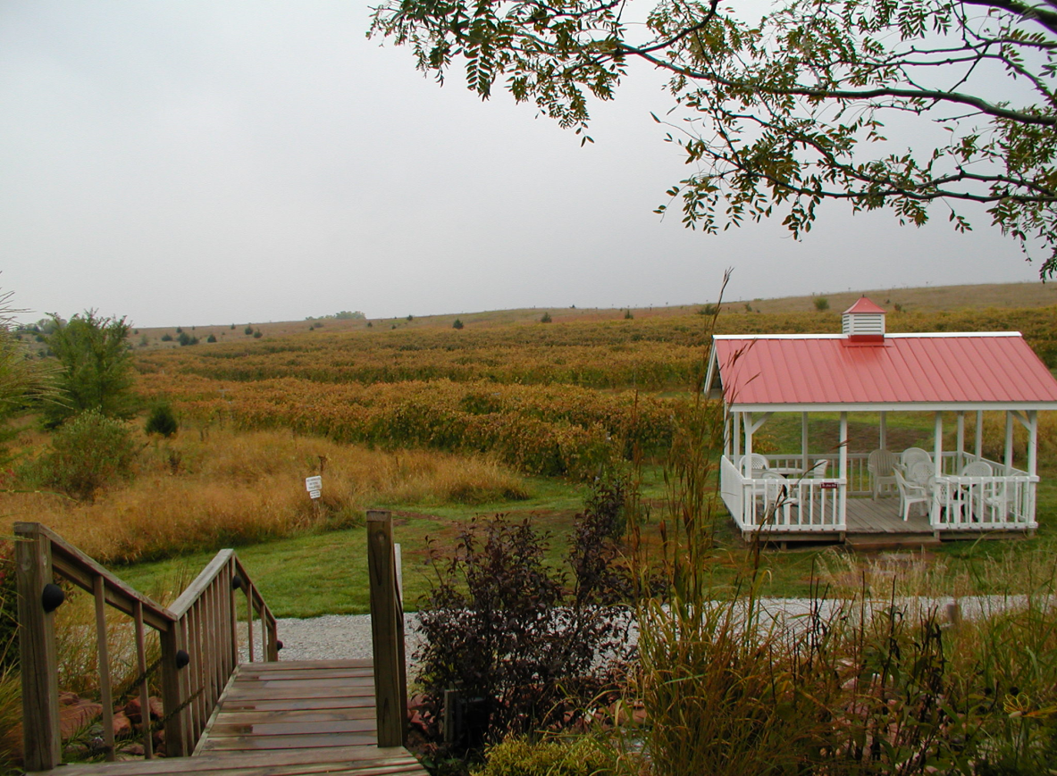
April 2000- “On-Vineyard” cooperative
research began at James Arthur Vineyards
with the
University of
Nebraska
Viticulture
Program

Slide 13
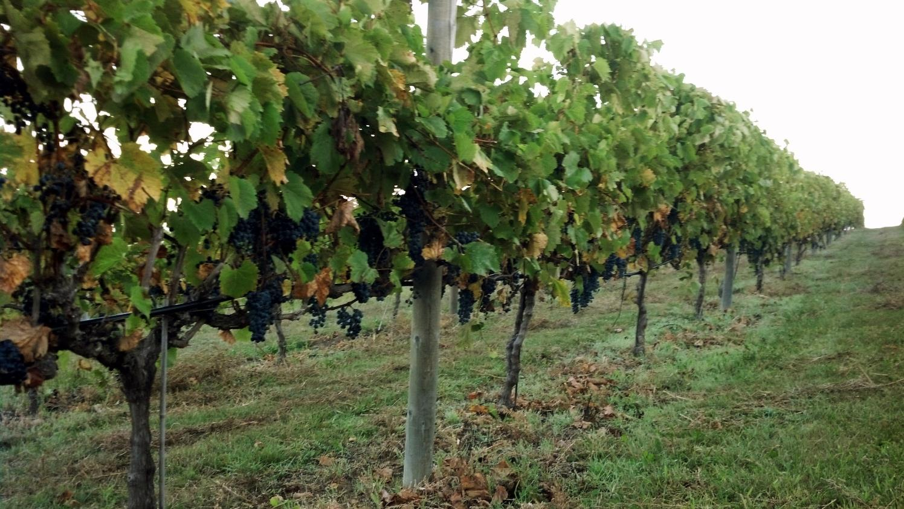
Twenty-seven Years Ago
-no wineries in Nebraska
-ca. 10 acres of
commercial
grapes

Slide 14
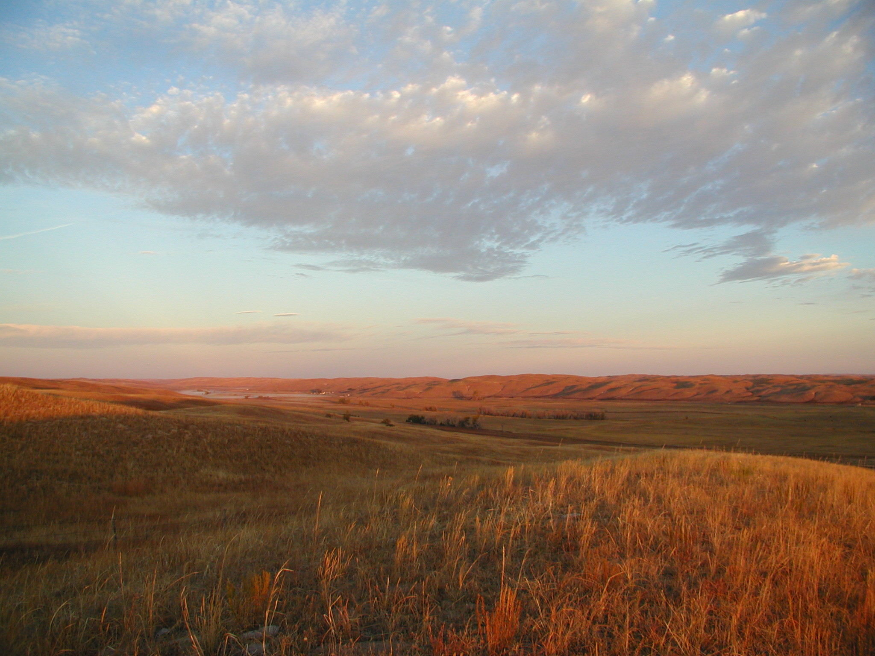
Today in Nebraska:

Slide 15
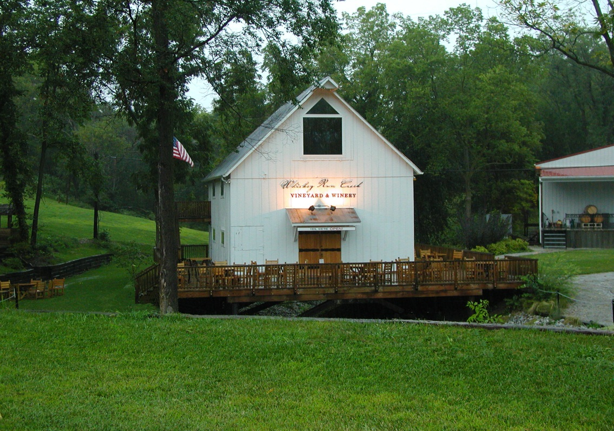
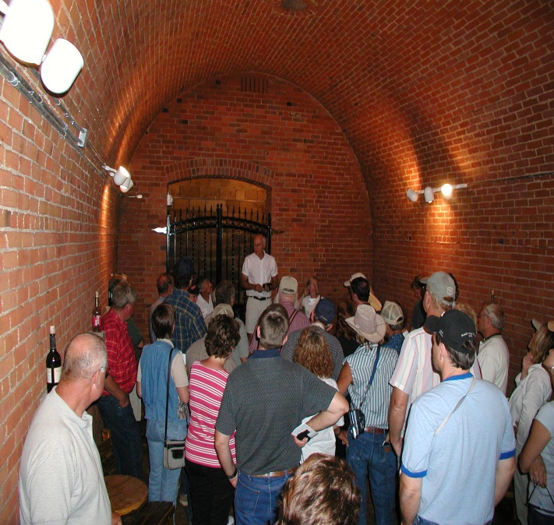
Thirty-two
Licensed Wineries

Slide 16
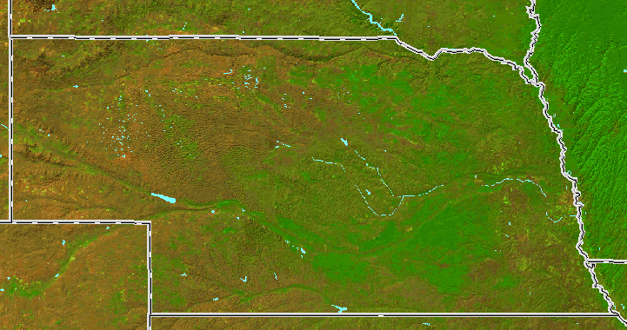
32 Licensed Wineries
George Paul Vinegar
Niobrara Valley Vineyard
Nissen Wine
Papa Moon Vineyard
Cuthills Vineyards (1994)
Silver Hills Winery
Miletta Vista Winery
Prairie Creek
Big Cottonwood
17 Ranch
Cedar Hills Winery
Makovicka
Cellar 426
Feather River
Windcrest
Soaring Wings Vineyard
James Arthur Vineyards
Junto Wine
Deer Springs
Mac’s Creek Vineyard
Prime Country Winery
Glacial Till
3 Brothers
Lazy Horse
Whiskey Run Creek Vineyard & Winery
Broken Arrow Cellars
Capital View
Sage Hill
Superior Estates
Schilling Bridge Winery
and Microbrew
Rich Harvest

Slide 17
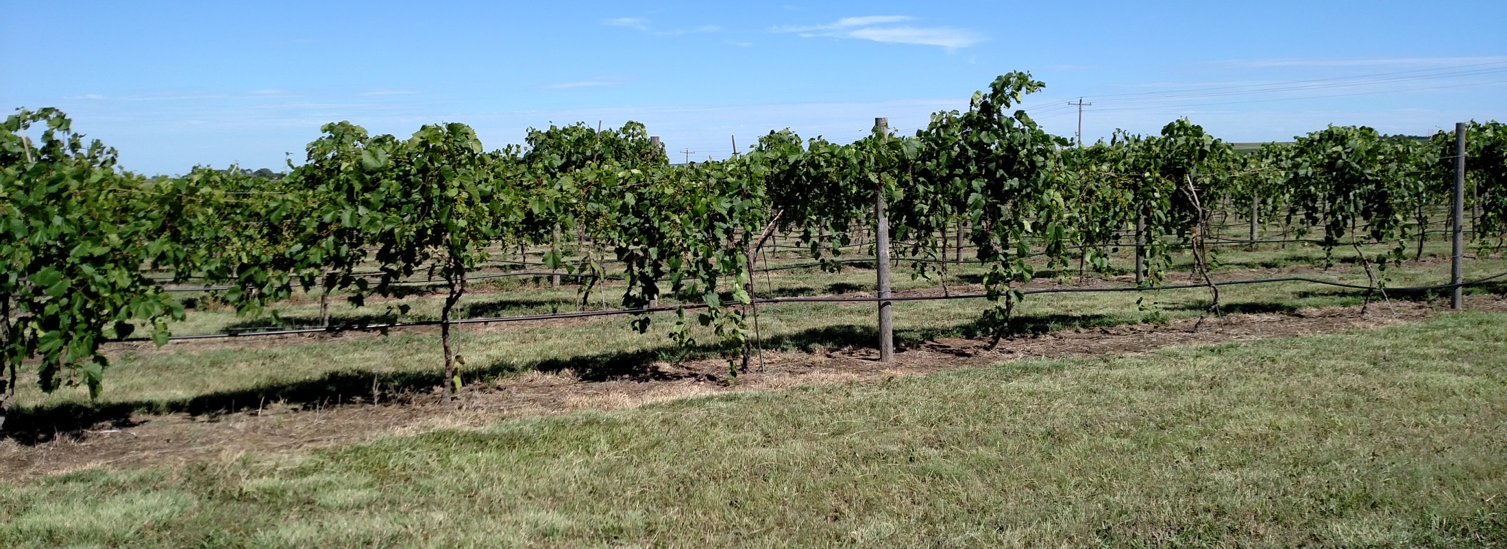
400 plus acres of grapes grown in Nebraska
viticulture.unl.edu
Notes:
Wine America The National Association of American Wineries

Slide 18
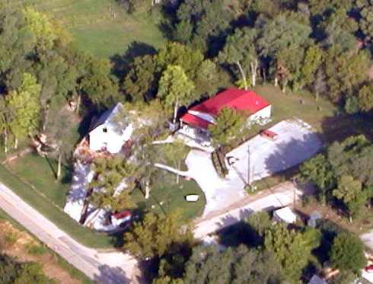
Wineries Stimulate
Economic Growth

Slide 19
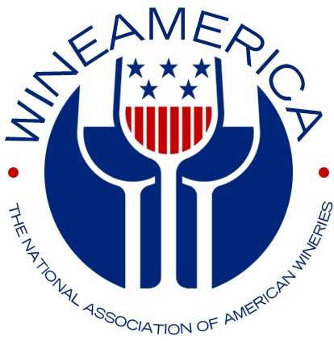
The production, distribution, sales, and consumption of wine in Nebraska
benefits many sectors of the state’s economy and generates close to
$873.3 million in total economic activity. This ultimate value-added product
preserves agricultural land, provides American jobs, attracts tourist, generates
taxes, and enhances the quality of life.
2017 Economic Impact Report on American Wine Industry
Prepared by John Dunham & Associates, New York
For methodology or additional information visit
wineamerica.org

Slide 20
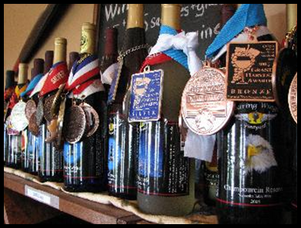
Nebraska Wines are Winning Awards
Florida Int’l Competition
Best of Show Blush/Rose 2015
Macs Creek Winery & Vineyard
Best White Wine in 2012
James Arthur Vineyards
Best White Wine in 2010
Miletta Vista Winery
Best White Wine in 2007
Schillingbridge Winery and Microbrewery
Monterrey
Int’l Wine Competition
Best White Wine of Show 2010
James Arthur Vineyards
Los Angeles
Int’l Wine Competition
Best White Wine of Show 2010
James Arthur Vineyards

Slide 21
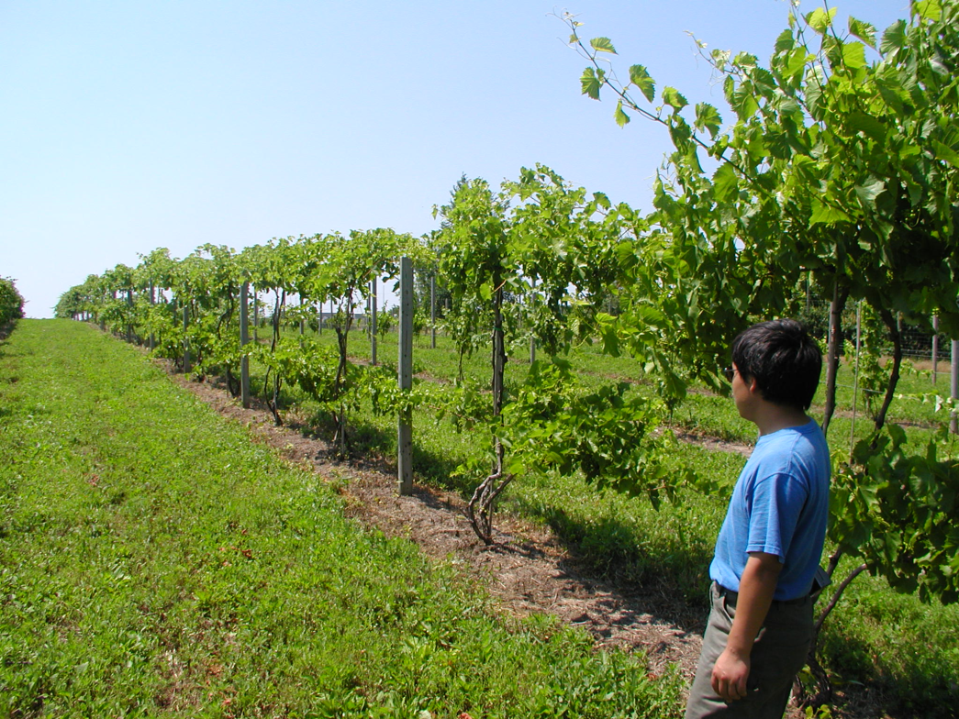
Research Focus by the
University of Nebraska
Viticulture Program

Slide 22
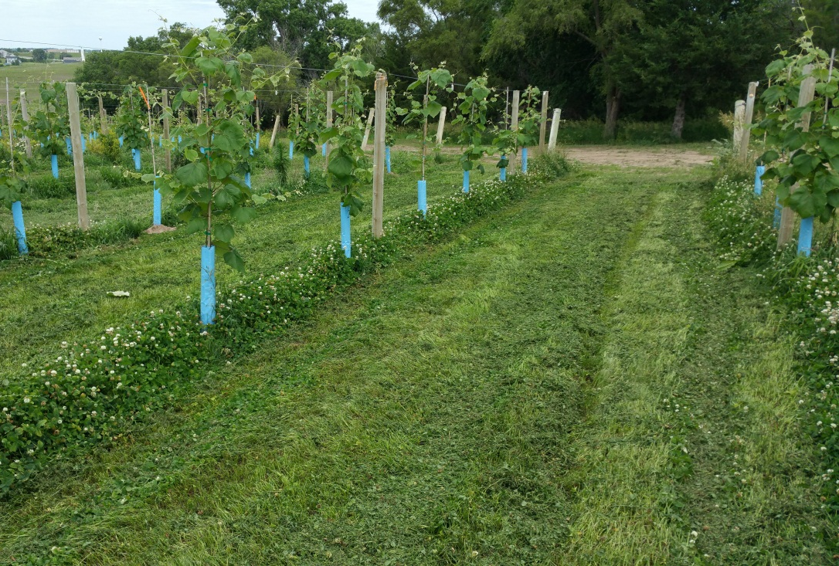
Cover Crops & Vineyard
Floor Management
Ben Loseke, Lab Technician,
PhD Student

Slide 23
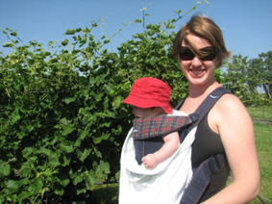
Trellis Study
Data Summary
2009
Mid-day % trans:
June 29: GDC and HC > all others
August 8: SHA > all others; GDC, HC, and VSP > SD and SHB
September 18: GDC > HC > all others
LLN: GDC had lowest, but not significantly different from HC, SHA, or SHB
pH: Most values were much higher than in 2008. GDC had 2nd lowest, but
similar to 2008. SHB > GDC > HC
TTS: values were lower than in 2008; GDC had 2nd lowest; SD and VSP were sig. higher
TA: values were lower than in 2008; GDC had 2nd highest, but only sig. lower than SHB
Yield: GDC had highest yield (4.2 kg/plant); significantly higher than SHB, VSP, and HC
Christina Bavougia, PhD Student

Slide 24
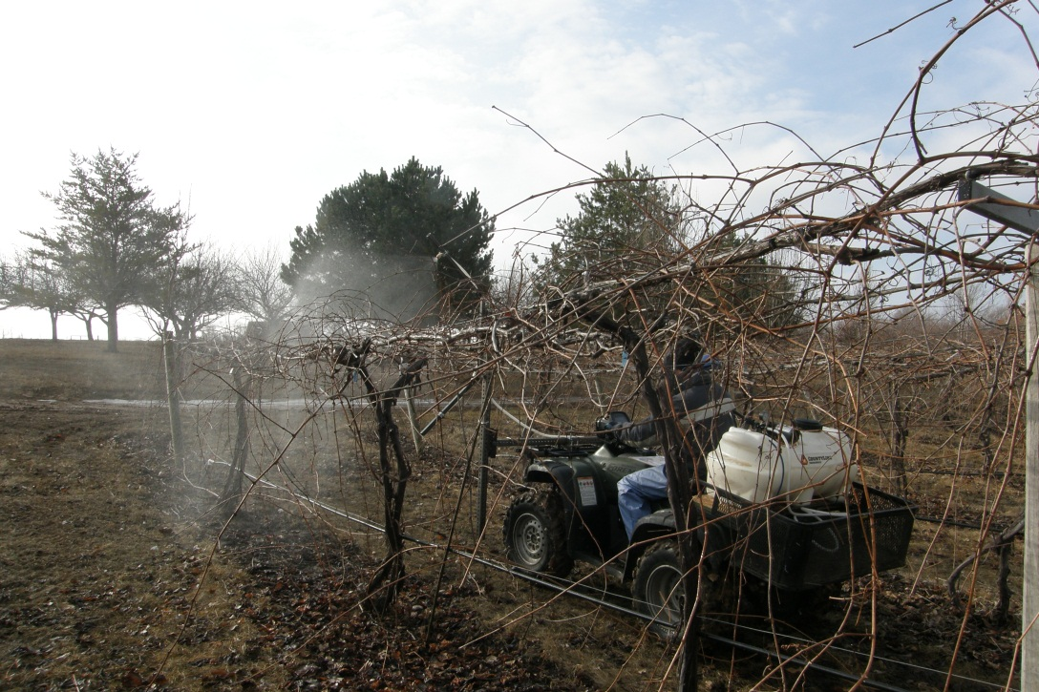
Overcoming Diseases &
Cold Temperature Events

Slide 25
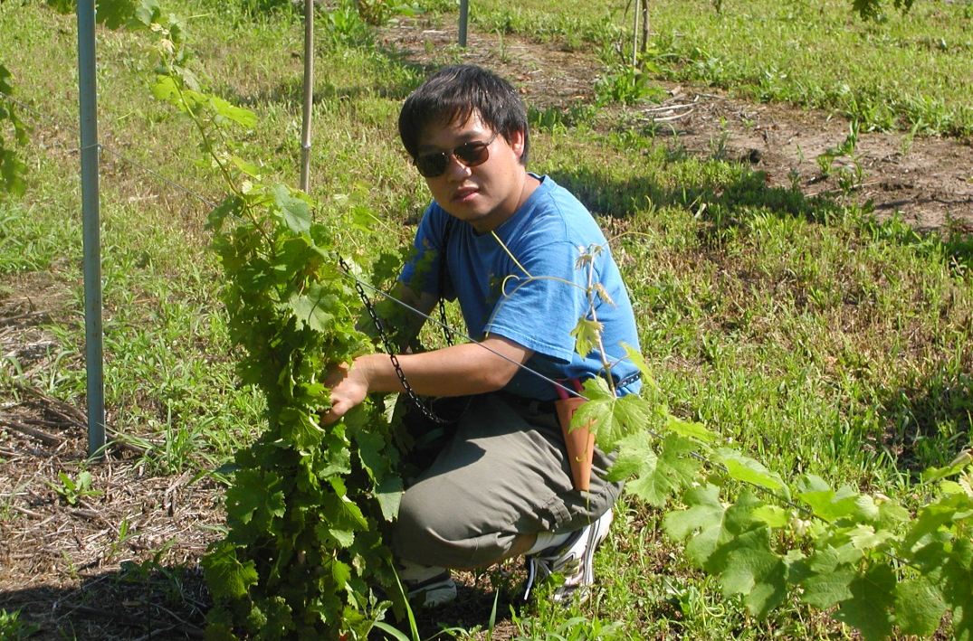
Rootstock
Studies
Sanjun Gu, PhD Graduate

Slide 26
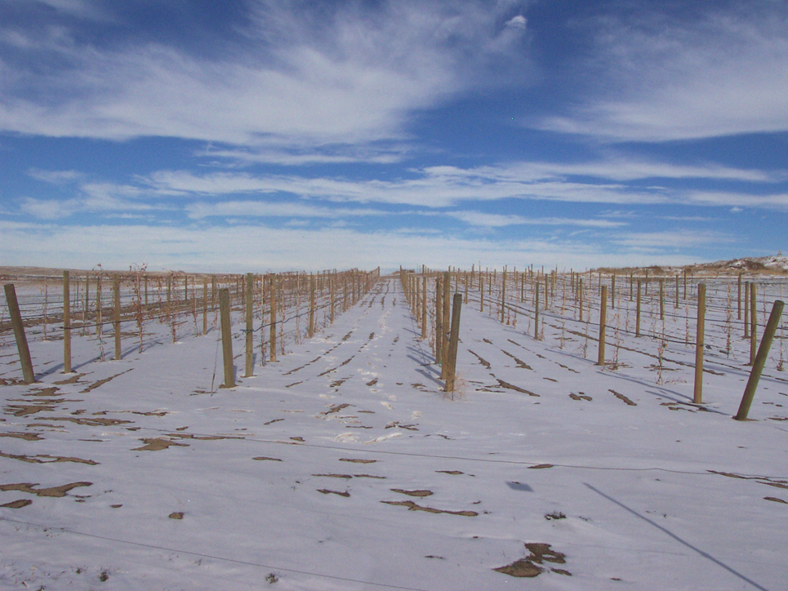
Cold Hardiness

Slide 27
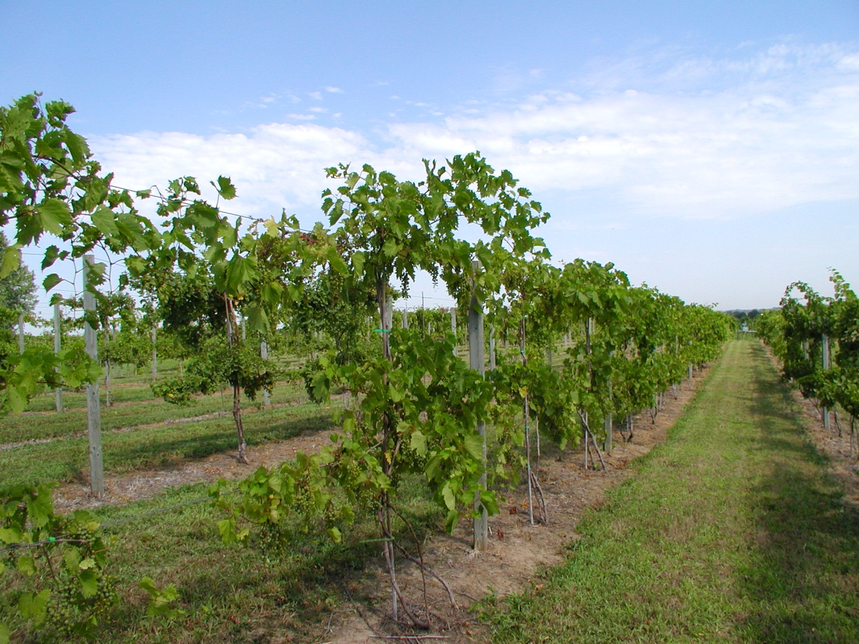
Weed Management

Slide 28
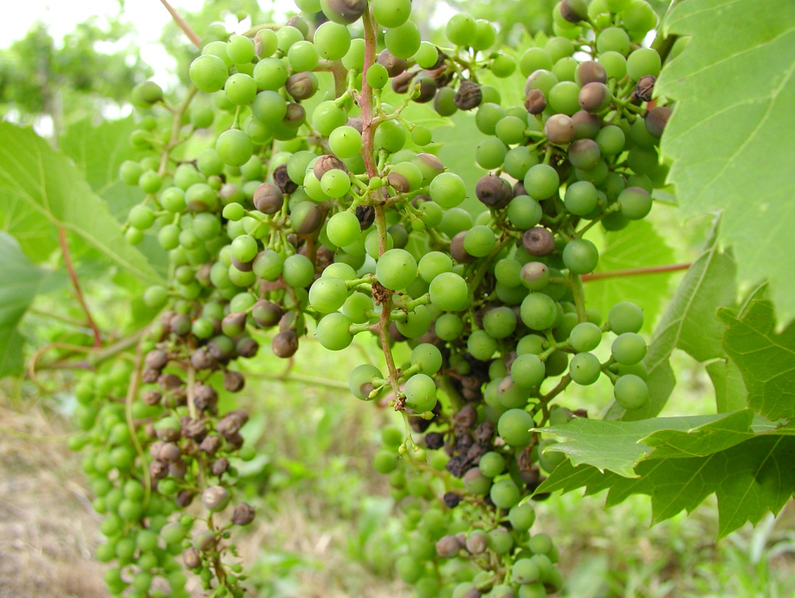
Disease Control
Notes:
Good wine out of good grapes

Slide 29
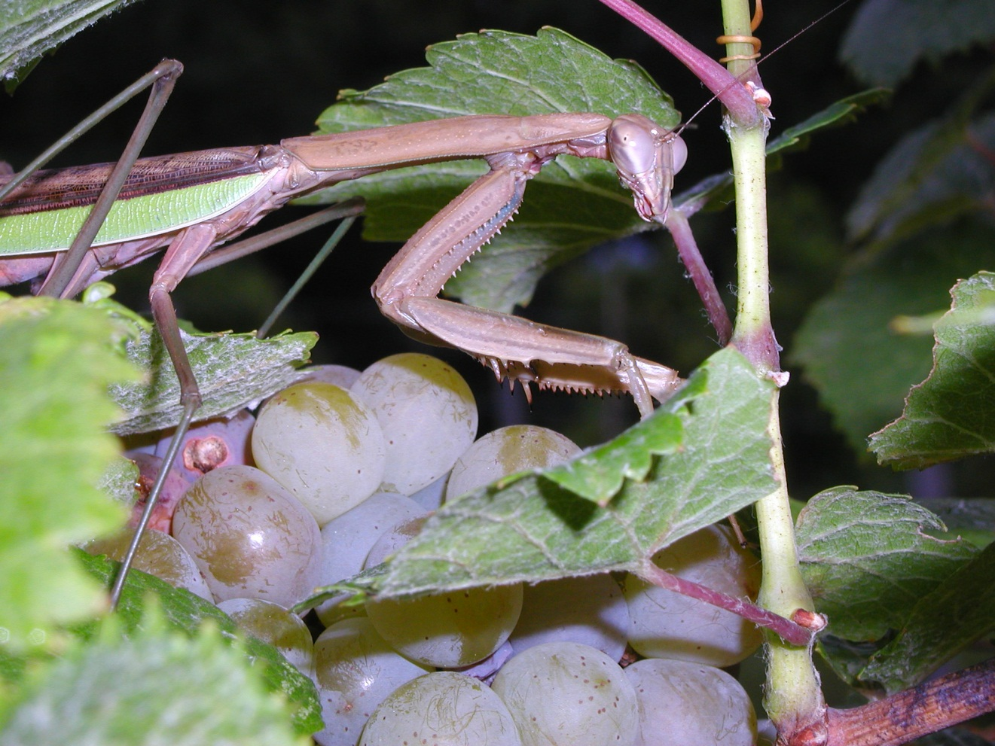
Potential for Organic
Production

Slide 30
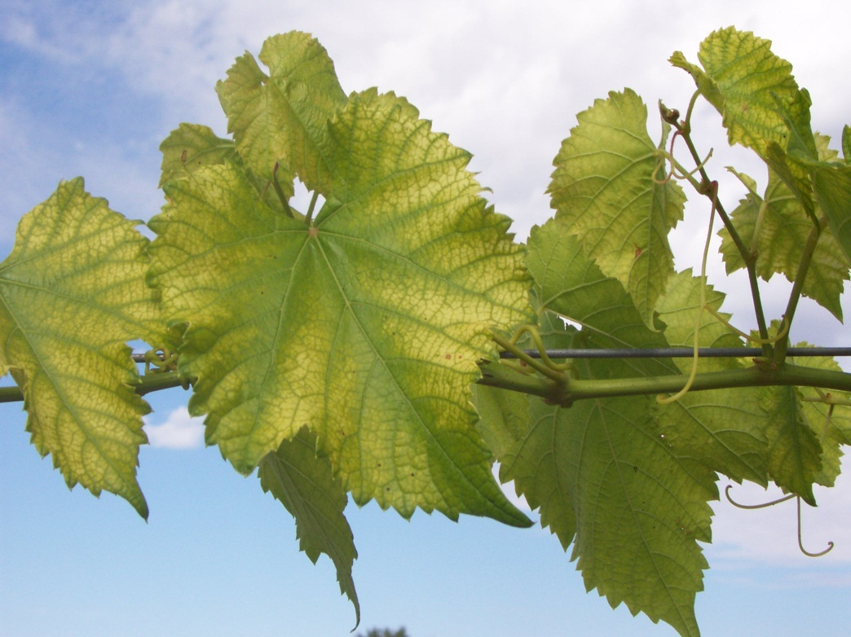
Fertilizer and
Nutrient Studies

Slide 31
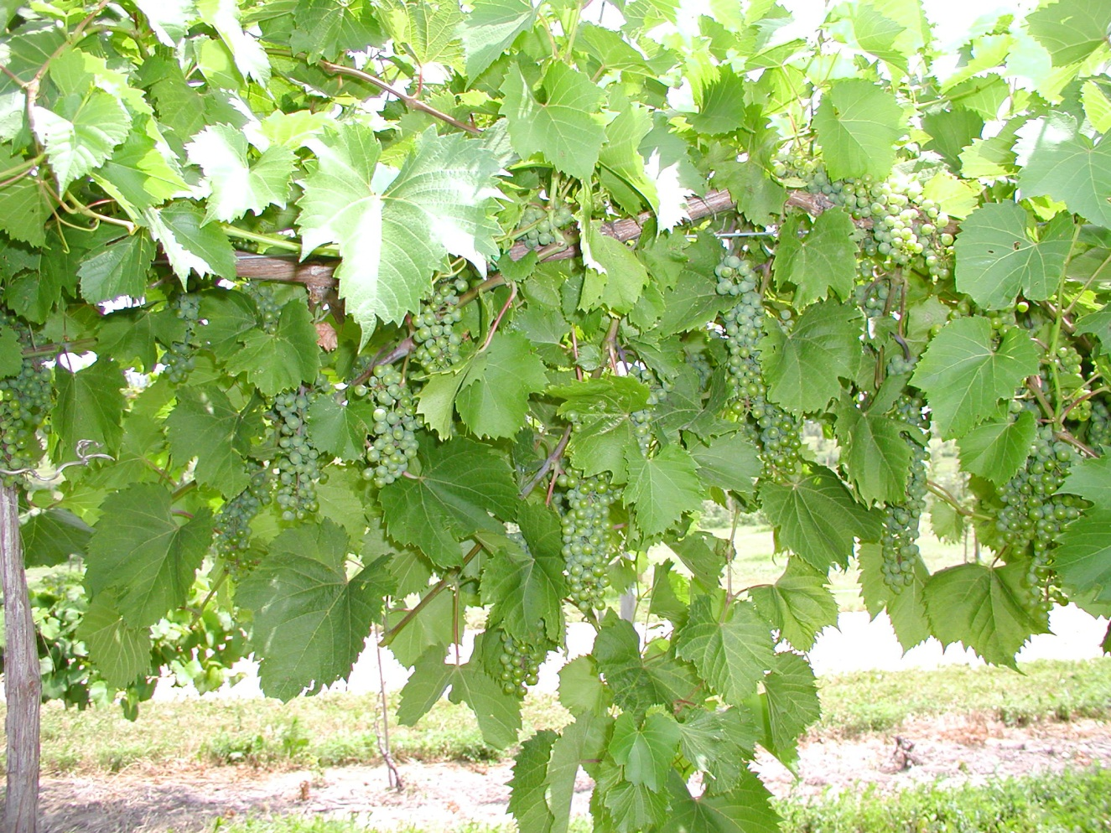
Cultivar (“Variety”)
evaluation

Slide 32
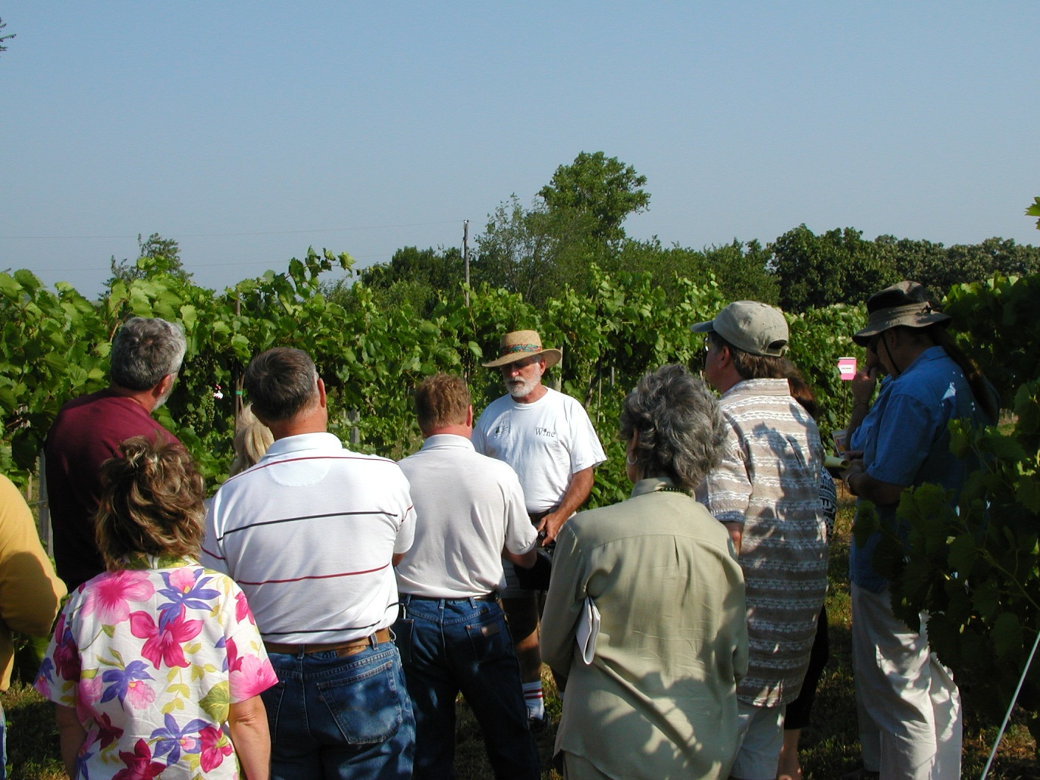
Field Days or Tailgates

Slide 33
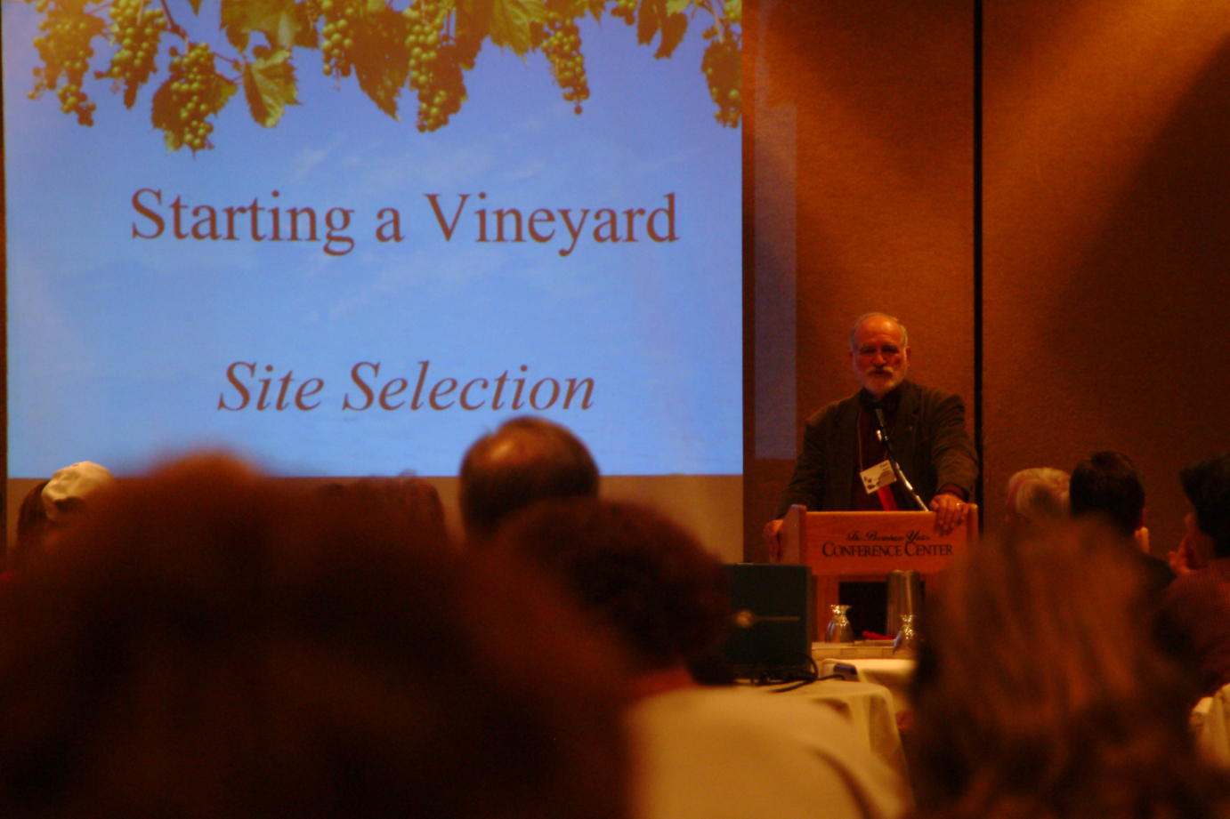
Workshops and
Conferences

Slide 34
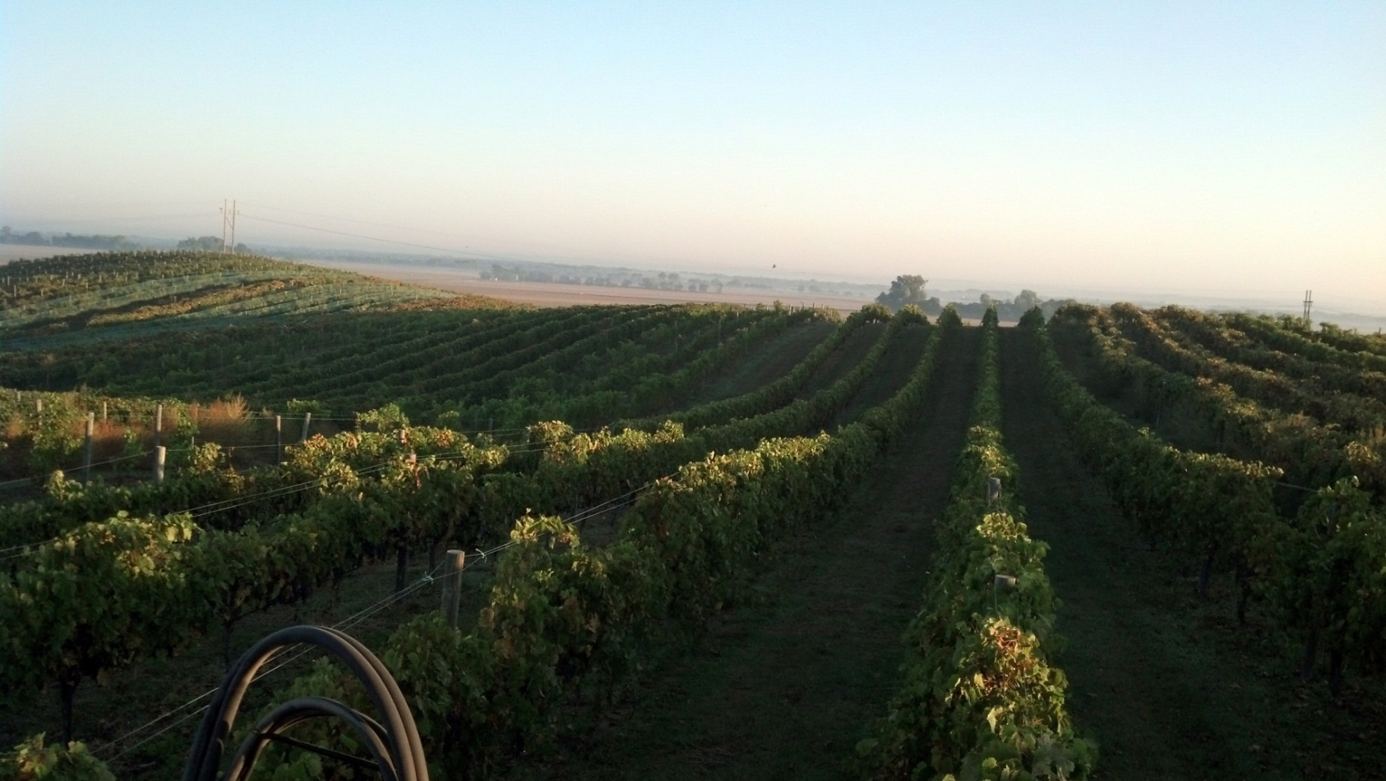
What’s Does The Future
Hold for The Industry?

Slide 35
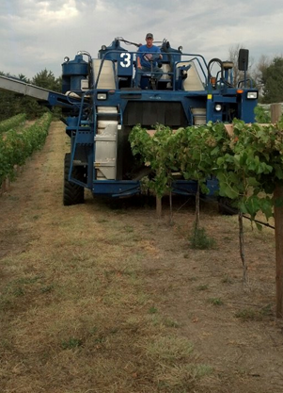
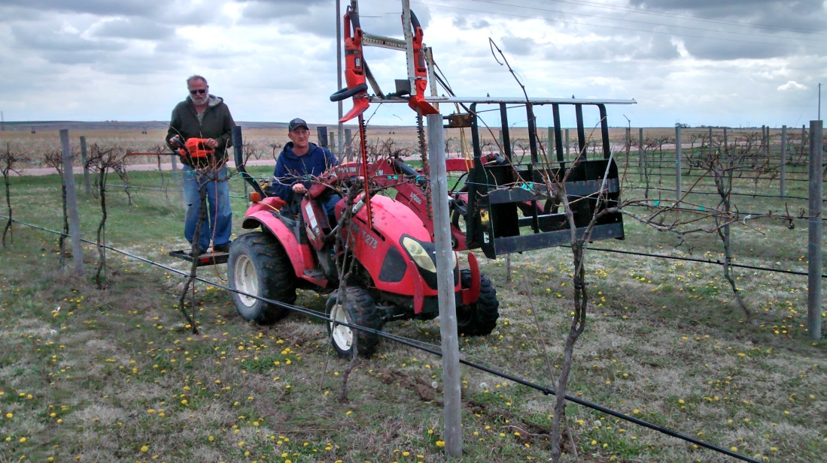
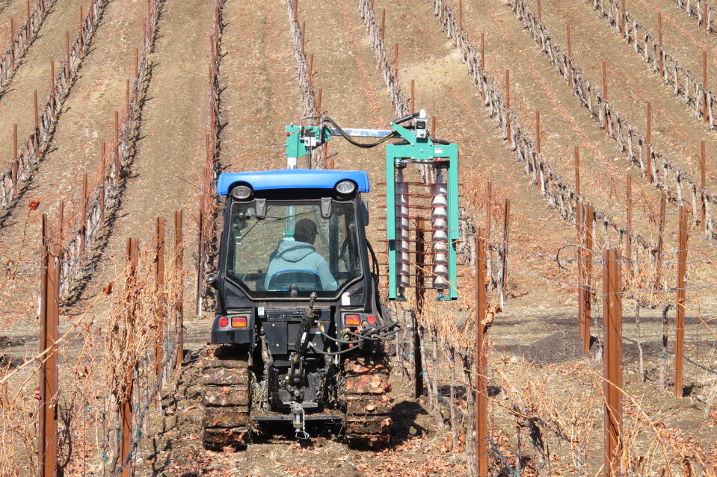
Mechanization
Notes:
Harvest cost – hand labor cost .20 to .25 cents per pound Machine low is .03-.04 cents to average .10 cents.
3-3.5 % current percentage of total wine sales that Nebraska wines control
Goal in 6-7% of total sales,
Increase of grape acres double of the current acres plus

Slide 36
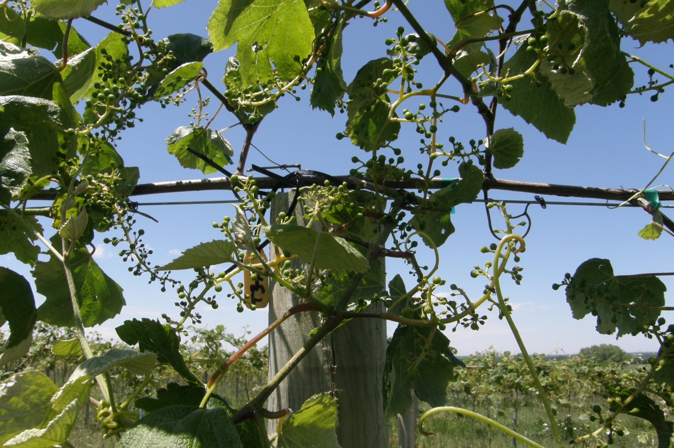
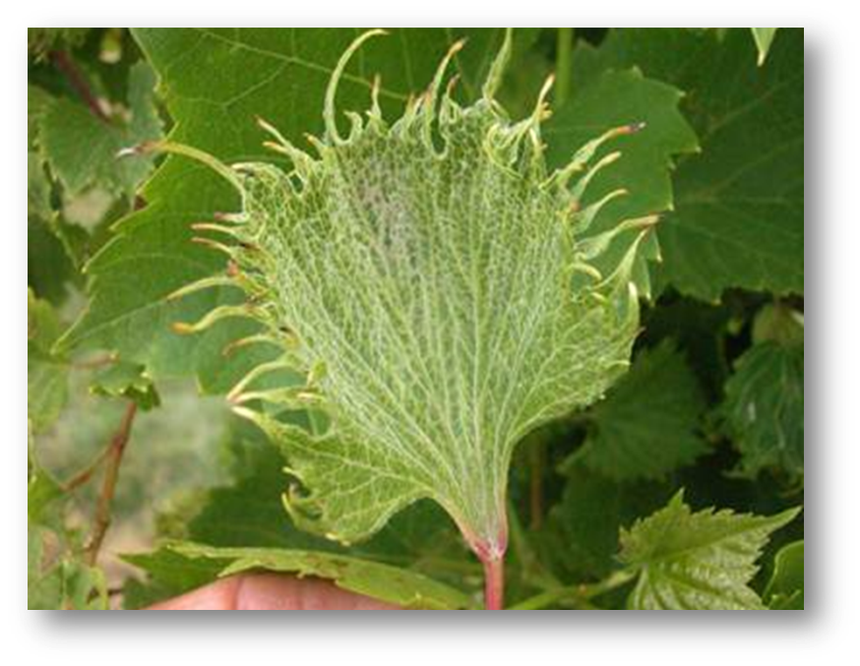
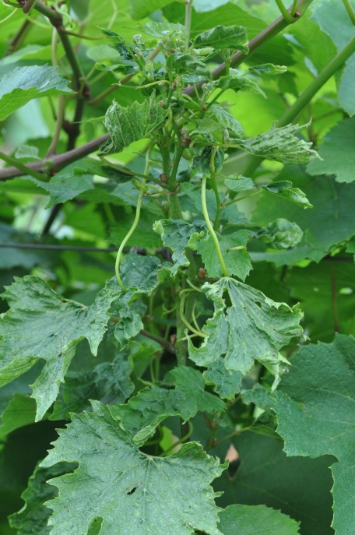
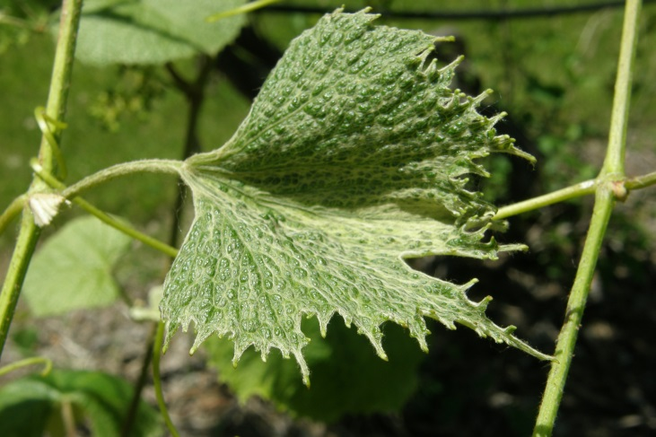
Spray Drift
Notes:
Not a annual crop, damage next years buds and the carry over in the plant itself.
Organic certification
Mom’s tomato garden
Drift Watch or Field Watch

Slide 37
Worlds Major Wine Regions
Notes:
Europe - bordeaux, chianti, riesling, tempranillo, port, claret
South Africa - Chenin Blanc, Australia- shiraz, New Zealand - Sauvignon Blanc
South America – malbec, New York – riesling, Cab franc, Cal. cabernet sauvignon, Chardonnay
Oregon - Pinot Noir – desert wine
Best wine makers in the midwest 75-25%

Slide 38
Grape Breeding
Temparia
Ed Swanson
Edelweiss
St. Croix
Lacrosse
Brianna
Elmer Swenson
Notes:
Bruce Bordelon
Peter Hemstead
Tom Plocher

Slide 39
The University of Nebraska
Viticulture Program
has dedicated people
Paul Read, Professor of Horticulture
Stephen Gamet, Viticulture Technician
Ben Loseke, Lab Technician, PhD Graduate
Mustafa Unlu, current M.S. Student
Christina Bavougia, PhD Student
Valerie Courbon, French Student Summer Intern
Sanjun Gu, recent PhD Graduate
Hany Elnagger, recent PhD Graduate
Issam Qrunfleh, recent PhD Student

